Slide 1
CSE326 Internet Programming Laboratory Lecture #11 Part 1
Dr. Navneet Kaur

Slide 2
Outline
<script>
Variables
Operators

Slide 3
<script>
The <script> HTML element is used to embed executable code or data; this is typically used to embed or refer to JavaScript code.
<head>
<script>
. . .
</script>
</head>

Slide 4
<script>
<head>
<script src="javascript.js">
. . .
</script>
</head>

Slide 5
Variables
A variable is a container for a value, like a number we might use in a sum, or a string that we might use as part of a sentence.
var name = “Manish”;
or
let name = “Manish”;
or
const name = “Manish”;

Slide 6
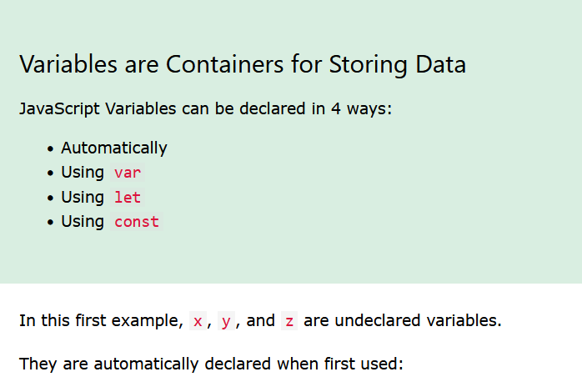

Slide 7
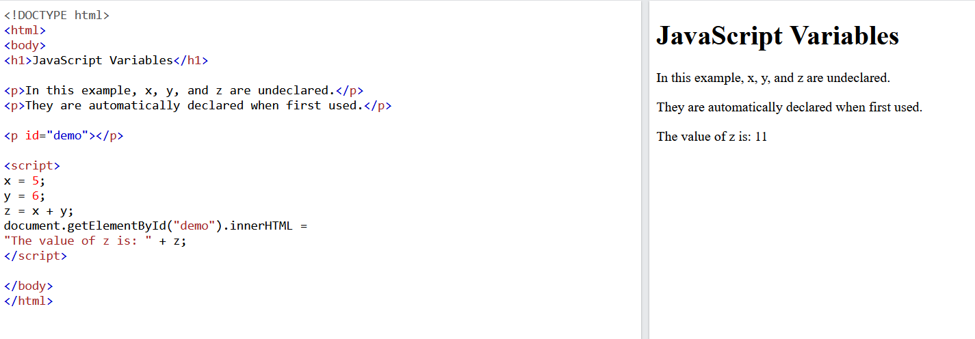

Slide 8
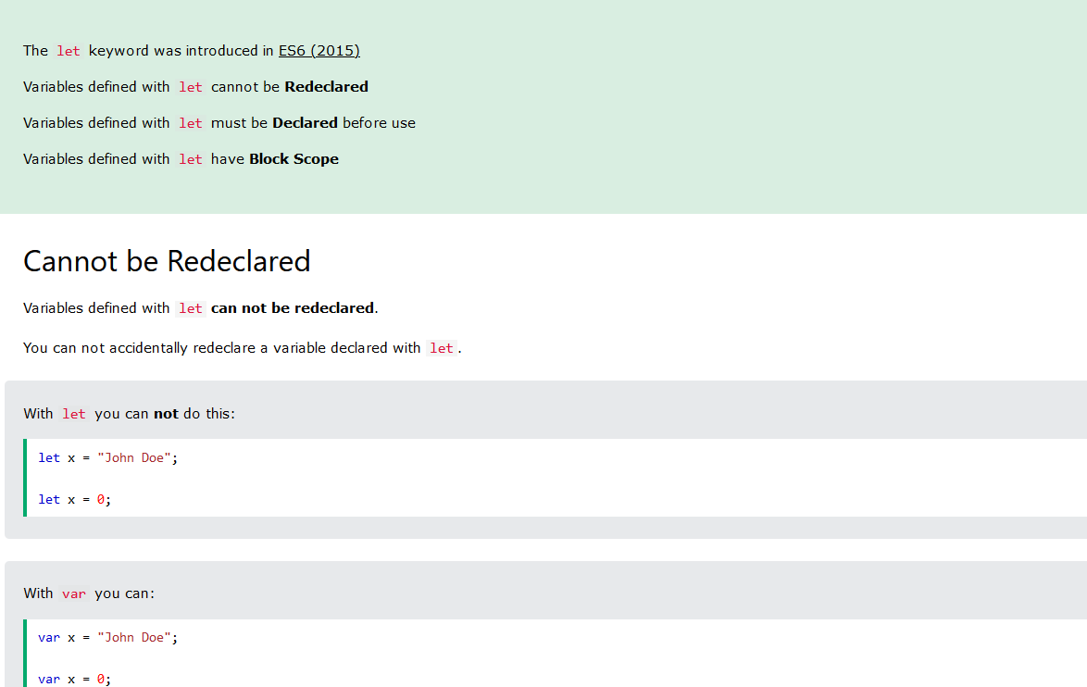

Slide 9
Operators
Arithmetic operators
Assignment operators
Comparison operators
Logical operators
String operators
Conditional (ternary) operator

Slide 10
Arithmetic Operators
Remainder (%)
Increment (++)
Decrement (--)
Unary negation (-)
Unary plus (+)
Exponentiation operator (**)

Slide 11
Assignment Operators
Name | Shorthand operator | Meaning
Assignment | x = f() | x = f()
Addition assignment | x += f() | x = x + f()
Subtraction assignment | x -= f() | x = x - f()
Multiplication assignment | x *= f() | x = x * f()
Division assignment | x /= f() | x = x / f()
Remainder assignment | x %= f() | x = x % f()

Slide 12
Comparison Operators
Operator | Description | Examples returning true
Equal (==) | Returns true if the operands are equal. | 3 == var1 "3" == var1 3 == '3'
Not equal (!=) | Returns true if the operands are not equal. | var1 != 4 var2 != "3"
Strict equal (===) | Returns true if the operands are equal and of the same type. | 3 === var1
Strict not equal (!==) | Returns true if the operands are of the same type but not equal, or are of different type. | var1 !== "3" 3 !== '3'

Slide 13
Comparison Operators
Operator | Description | Examples returning true
Greater than (>) | Returns true if the left operand is greater than the right operand. | var2 > var1 "12" > 2
Greater than or equal (>=) | Returns true if the left operand is greater than or equal to the right operand. | var2 >= var1 var1 >= 3
Less than (<) | Returns true if the left operand is less than the right operand. | var1 < var2 "2" < 12
Less than or equal (<=) | Returns true if the left operand is less than or equal to the right operand. | var1 <= var2 var2 <= 5

Slide 14
Logical operators
Logical operators are typically used with Boolean (logical) values.
Logical AND (&&) -> expr1 && expr2
Logical OR (||) -> expr1 || expr2
Logical NOT (!) -> !expr

Slide 15
String operators
The concatenation operator (+) concatenates two string values together, returning another string that is the union of the two operand strings.
console.log("my " + "string");

Slide 16
Conditional (ternary) operator
The conditional operator is the only JavaScript operator that takes three operands. The operator can have one of two values based on a condition.
condition ? val1 : val2
const status + age >= 18 ? "adult" : "minor";

Slide 17
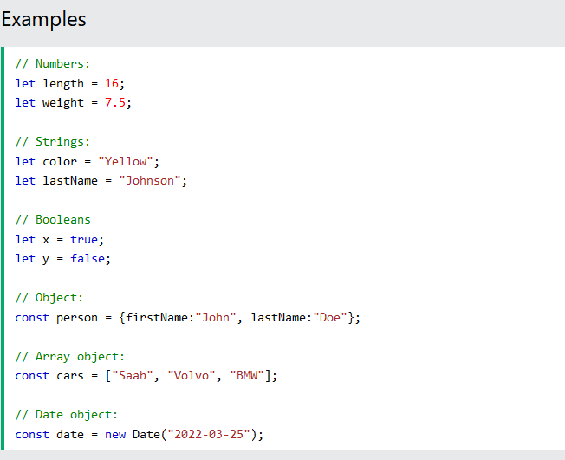
JS DATA TYPES

Slide 18
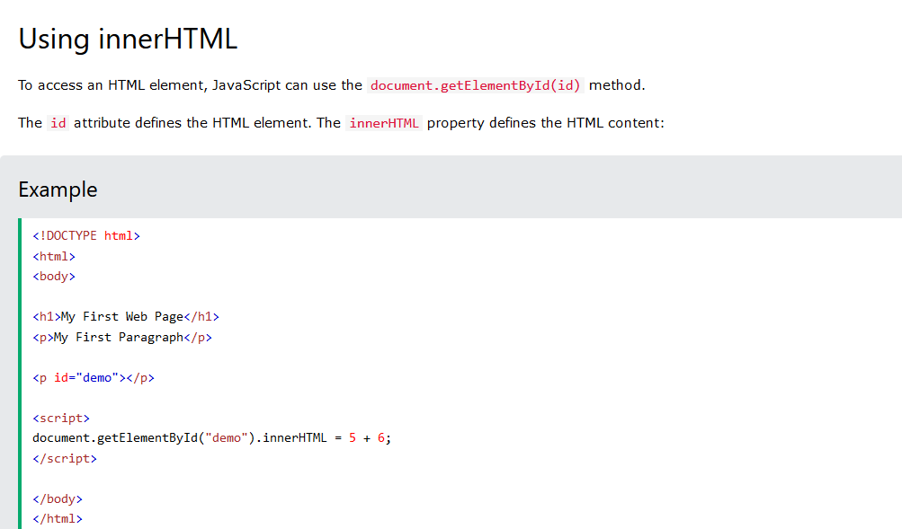

Slide 19
References
https://www.w3schools.com/js/js_arithmetic.asp
https://www.w3schools.com/js/js_assignment.asp
https://www.w3schools.com/js/js_comparisons.asp
https://www.geeksforgeeks.org/javascript-ternary-operator/

Slide 20
Program link
https://onlinegdb.com/7xNzMPxDa

Slide 21
Thank you

